Slide 1


Slide 2
About today…
File Handling
Permissions
File Manipulation

Slide 4



Intro to Advanced File Handling
File handling is crucial for many web applications
Advanced file handling includes managing file permissions and various file manipulation techniques
File permissions control who can read, write, and execute files
Permissions are essential for securing your files and directories
Permissions are typically represented in a combination of letters and numbers
Letters: r (read), w (write), x (execute)
Numeric values (octal notation): 4 (read), 2 (write), 1 (execute)

Slide 5
File Permission Modes
Numeric (Octal) Mode
Represents permissions using three or four-digit numbers
Example:
0755
Owner: 7 (Read + Write + Execute)
Group: 5 (Read + Execute)
Others: 5 (Read + Execute)
Symbolic Mode
Uses letters to specify permissions
Example:
rwxr-xr-x
Owner: rwx (Read, Write, Execute)
Group: r-x (Read, Execute)
Others: r-x (Read, Execute)

Slide 6

Changing File Permissions
chmod() function
Changes the file mode
Example
File
example.txt
Change permissions to 0755
Explanation
filename
Path to the file
0755
Desired permission mode
Use Case
Grant execute permissions to a script file

Slide 7
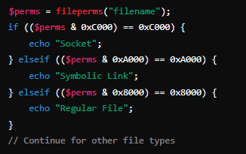

Checking File Permissions
Explanation
fileperms() function
Retrieves file permissions
fileperms()
Returns the permissions of the file
Example
Check permissions of example.txt
Bitwise operations are used to determine the file type

Slide 8
File Manipulation Overview
Reading and writing files
Creating and deleting files
Moving and copying files
Renaming files
File manipulation is crucial for tasks like data storage, configuration management, and content generation

Slide 9


Reading Files
Functions
fopen(), fread(), and fclose()
Explanation
fopen()
Opens a file
Example
Write to output.txt
fwrite()
Writes to the file
fclose()
Closes the file

Slide 10


Writing to Files
Functions
fopen(), fwrite(), and fclose()
Explanation
fopen()
Opens a file
Example
Read contents of data.txt
fread()
Reads the file
fclose()
Closes the file

Slide 11



Creating and Deleting Files
Creating a File
fopen() with write mode (w)
Example
Deleting a File
unlink() function
Create a new file example.txt:
Example
Delete the file example.txt

Slide 12


Moving and Copying Files
Moving a File
rename() function
Example
Move example.txt to a new directory
Copying a File
copy() function
Example
Copy example.txt to copy_example.txt

Slide 13


Renaming Files
rename() function
Explanation
oldname.txt
Current name of the file
newname.txt
New name for the file
Example
Rename document.txt to archive.txt

Slide 14
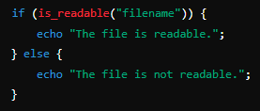
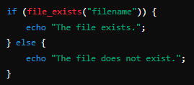
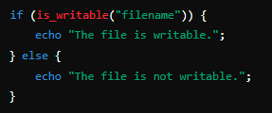
Error Handling in File Operations
is_readable()
Checks if a file is readable
Importance
Ensures robustness of file operations
Prevents data loss and application crashes
Common functions
file_exists()
Checks if a file exists
is_writable()
Checks if a file is writable

Slide 15
Best Practices for File Handling
Always close files after operations
Ensures file handles are released
Prevents memory leaks and data corruption
Use relative paths for better portability
Example: ../files/example.txt
Implement proper error handling
Check if files exist before reading/writing
Handle exceptions using try-catch blocks
Regularly check and update file permissions
Ensure files are accessible only to authorized users
Example: Update permissions of sensitive files

Slide 16


Slide 17

What does the chmod() function do in PHP?
It changes the file permission
What numeric value represents read and write permissions in octal notation?
6 (4 for read + 2 for write)
Which function is used to open a file in PHP?
fopen()
How do you delete a file in PHP?
What is the purpose of the fileperms() function?
Using the unlink() function
It retrieves the permissions of a file
Which function checks if a file exists in PHP?
file_exists()

Slide 18

Task
Create a simple PHP script to manage files within a specified directory, incorporating file creation, reading, writing, renaming, copying, moving, and deletion functionalities. The script should also handle file permissions

